Slide 1

Tata: Data
Visualization
Analysis Summary
By Babitha Ravindra

Slide 2
CONTENTS
Introduction
Process
Analysis
Reccomendations

Slide 3

INTRODUCTION
Objective
To present the sales perfomance of TATA Consultancy Services (TCS) for the financial years 2010-11

Slide 4
PROCESS
1
2
3
4
5
Critical Thinking
Data Wrangling
Choosing Visuals
Dashboard Making
Summarise
Analyse the required data insights for decion making from the CEO’s & CMO’s Point of View
Clean and Transform Data for for better visualization. Missing values were dealt by removing that row of data
Choose the right visuals to effectively communicate insights and enable informed decision-making
Create a dashboard to provide a centralised view of all key perfomance metrics (KPIs)
Providing the reults of the analysis and reccomendations to the CEO & CMO for enhanced decision making

Slide 5
ANALYSIS
1
2
3
4

Slide 6
ANALYSIS
2
3
4
Revenue of the company for the year 2011 month-wise

Slide 7
ANALYSIS
1
3
4
Top 10 Countries by Revenue and their Quantity

Slide 8
ANALYSIS
1
2
4
Top 10 Customers by Revenue

Slide 9

ANALYSIS
1
2
3
Revenue by Countries

Slide 10
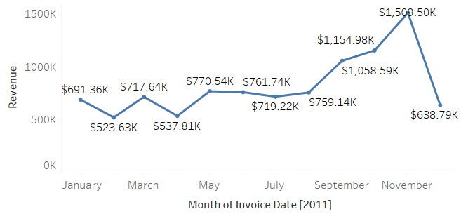
Revenue of the Company in the year 2011 by Month

Slide 11
Revenue of the Company in the year 2011 by Month
The first 8 months had stable monthly revenues with minor fluctuations. The average revenue was $685,000.
A significant spike in revenue from September with the revenue at $1.15 Million in November and an average of 21.18% increase in revenue from August to November.
The revenue trend from August to December demonstrates how seasonality affects retail store sales

Slide 12
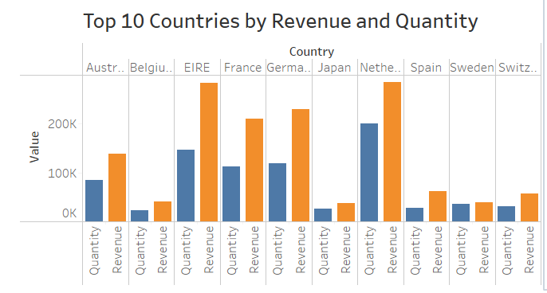
Top 10 Countries by Revenue & Their Quantity

Slide 13
Top 10 Countries by Revenue & Their Quantity
This chart represents the top 10 countries in the revenue and the quantities bought in these countries except The United Kingdom.
There is no major difference between the revenue and the quantity of goods sold in these countries, showing a high purchasing power in these countries .
These countries represent regions with the highest potential to generate more revenue that management needs to focus more on in terms of marketing strategies

Slide 14
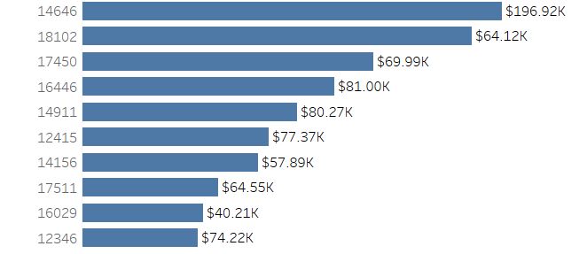
Top 10 Customers by Revenue
Customer ID

Slide 15
Top 10 Customers by Revenue
1
This charts show that there is no major difference between the top 10 customers in terms of revenue generated.
The average difference is revenue between the top 10 customers in 15.8%.
2
3
The company can aim to strengthen the relationship with these customers to increase customer loyalty and retention and ultimately drive more sales an revenue for the company.

Slide 16
Revenue by Country

Slide 17
Revenue by Country
01
The map also reveals that the majority of sales occur only in the European zone , with a small number in American region.
02
Along with Russia, there is no market for the items in Africa or Asia.
03
The company should focus on the European market, developing country-specific strategies to maximize sales there, as well as in Australia and Japan.

Slide 18

RECCOMENDATION
The company should come up with strategies that aim at stocking and advertising seasonal products to maximize sales when the demand for these goods goes up.
The company should do deeper analysis of products that are usually in high demand during low sales months to come up with strategies for marketing these products.
A deeper dive into the type of products and the revenue generated from these products for each region would be key in guiding region specific marketing strategies.
The top 1 customer should be incentivized with a family trip
The other top 4 should be incentivized with prizes so other cutomers are motivated to make purchases
The European market offers significant growth potential, and the company should prioritize strategies to strengthen its market position there.

Slide 19

THANK YOU
linkedin.com/in/
babitha-ravindra
github.com/
BabithaRavindra

